Slide 1
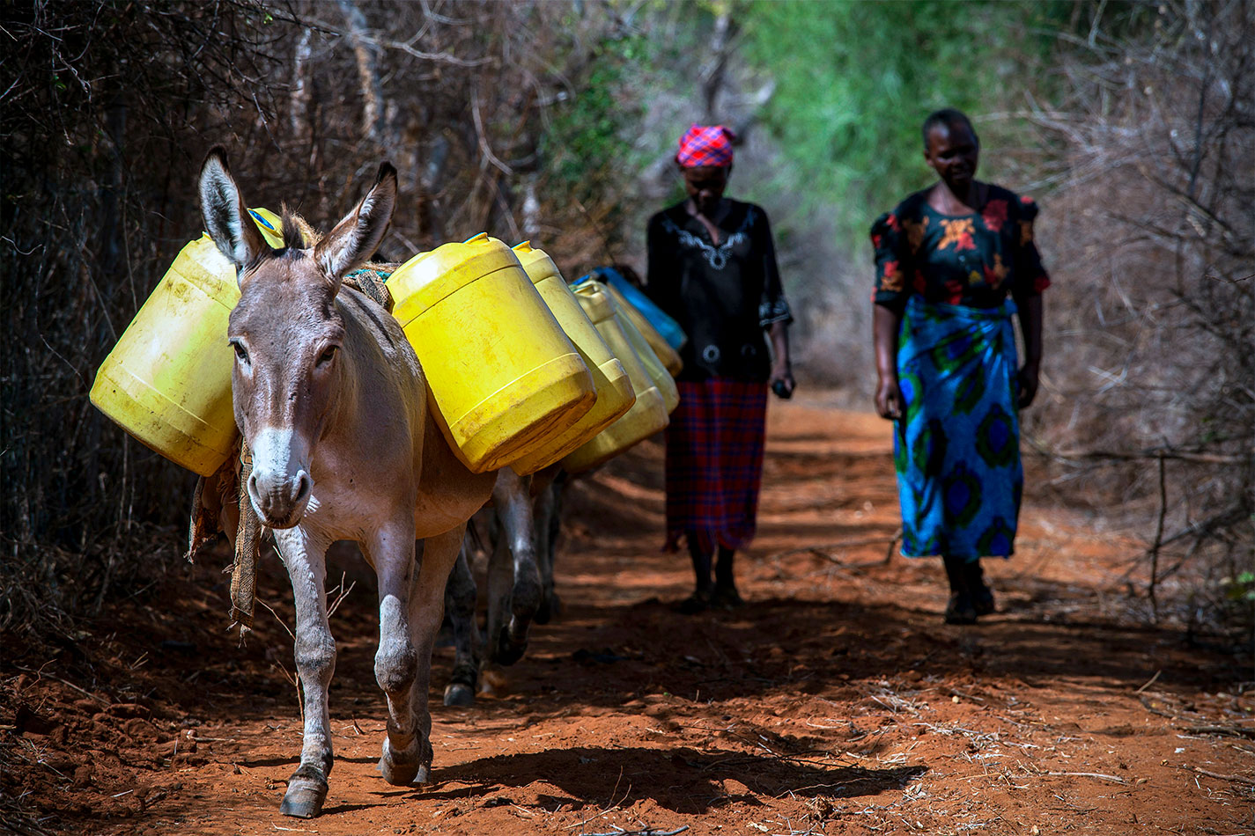
CERF
The Donkey Sanctuary’s Covid-19 Emergency Response Fund

Slide 2
The Donkey Sanctuary’s Covid-19 Emergency Response Fund
Background and Rationale
Donkeys and Mules are in increasing need globally. Coronavirus is an additional layer of emergency (on top of Climate Change, Poverty and inequality).
Emergency response for animals is often a lower priority with humanitarian and development actors despite increasing human reliance upon them.
The scale of the challenges and the relationship between animals and people require the efforts of Development and Humanitarian actors to work together for Donkeys and Mules and tackling poverty.
The scale of the need requires a coordinated and collaborative funding model that can leverage funds at scale.
Notes:
An example of how we at the DS are changing our response is in how we programme.

Slide 3
The Donkey Sanctuary’s Covid-19 Emergency Response Fund
Who can apply?
The fund is open to all applicant who meet all of the following criteria:
The project and the lead or implementing partner is based within Africa, Asia or the Americas.
The project is a response to a need arising from an emergency where coronavirus exacerbates underlying vulnerabilities.
The project demonstrates a positive impact, whether direct or indirect, on the welfare needs of working donkeys and mules, and the people who depend upon them.
The project is a short-term intervention (3-6 months).
Notes:
An example of how we at the DS are changing our response is in how we programme.

Slide 4
The Donkey Sanctuary’s Covid-19 Emergency Response Fund
Who can apply? (cont.)
The total grant requested from The Donkey Sanctuary for the project is between £15,000 and £30,000.
The applicant has previously delivered impactful work in the proposed context (with evidence if requested).
The applicant has a formally constituted governance structure in place.
The applicant has a designated ordinary business bank account.
The applicant is able to meet The Donkey Sanctuary’s Covid-19 Emergency Response Fund reporting criteria.
Notes:
An example of how we at the DS are changing our response is in how we programme.

Slide 5
The Donkey Sanctuary’s Covid-19 Emergency Response Fund
How to apply
The deadline for the current phase of applications is Friday 4 September 2020.
You can access all of the application documents via the website at: https://www.thedonkeysanctuary.org.uk/what-we-do/for-professionals/covid-19-emergency-response-fund
Please download the application form, and follow the instructions at the bottom of the document to send it back to us.
For further details on the requirements for each stage of application, please refer to the application guide and the frequently asked questions document.
Notes:
An example of how we at the DS are changing our response is in how we programme.

